Slide 1
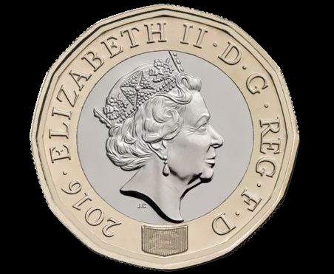

Slide 3
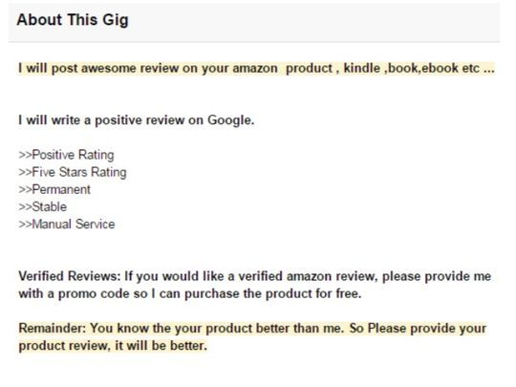

Slide 5
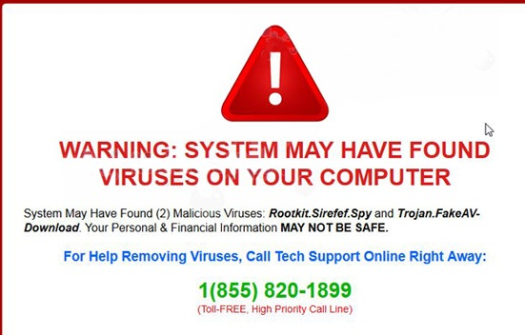

Slide 6
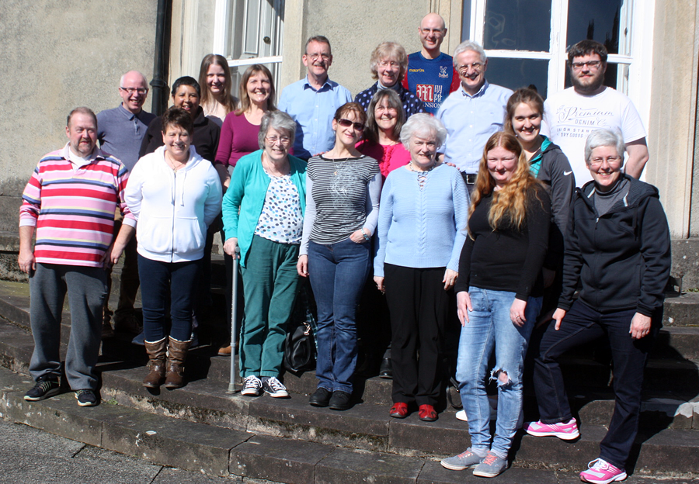

Slide 8
2 Cor 13:5 Examine yourselves to see whether you are in the faith; test yourselves. Do you not realize that Christ Jesus is in you--unless, of course, you fail the test?

Slide 9
1 Peter 1:7 These have come so that the proven genuineness of your faith--of greater worth than gold, which perishes even though refined by fire--may result in praise, glory and honor when Jesus Christ is revealed.

